Slide 1
Chapter 5
Network Layer

Slide 2
Types of Routing Algorithms
Nonadaptive (static)
Do not use measurements of current conditions.
Static routes are downloaded at boot time.
Adaptive Algorithms
Change routes dynamically
Gather information at runtime
locally
from adjacent routers
from all other routers
Change routes
Every delta T seconds
When load changes
When topology changes

Slide 3
Optimality principle
If router j is on the optimal path from i to k, then the optimal path from j to k also falls along the same route.
(j)
k
i
(j)
(j)

Slide 4
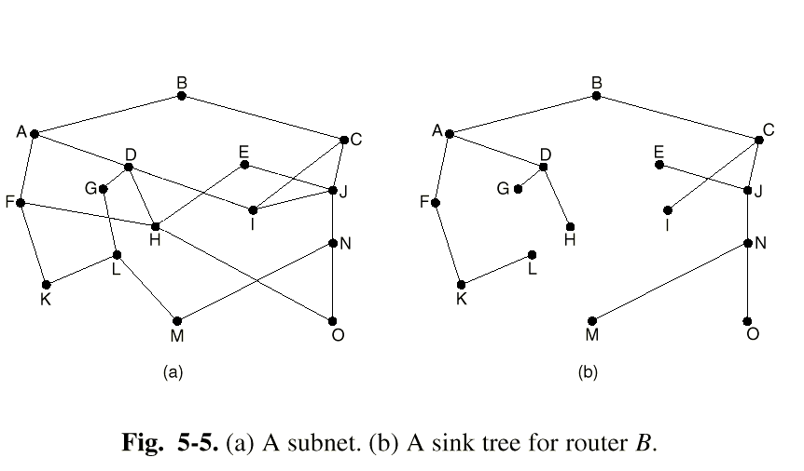
Sink Trees
The set of optimal routes to a particular node forms a sink tree.
Calles as Directed Acyclic Graph (DAG).
Sink trees are not necessarily unique.
Goal of all routing algorithms.
Discover sink trees for all destinations.

Slide 5
Shortest Path Routing
Given a network topology and a set of weights describing the cost to send data across each link in the network.
Find the shortest path from a specified source to all other destinations in the network.
Shortest path algorithm first developed by E. W. Dijkstra

Slide 6
Shortest Path Routing(1)
Optimization criterion:
Distance,
Bandwidth,
Average Traffic,
Communication cost,
Mean Queue Length,
Measured Delay.
Algorithms:
Dijkstra
Flooding
Selective Flooding

Slide 7
Shortest Path Routing(2)
Mark the source node as permanent.
Designate the source node as the working node.
Set the tentative distance to all other nodes to infinity.
While some nodes are not marked permanent
Compute the tentative distance from the source to all nodes adjacent to the working node. If this is shorter than the current tentative distance replace the tentative distance of the destination and record the label of the working node there.
Examine ALL tentatively labeled nodes in the graph. Select the node with the smallest value and make it the new working node. Designate the node permanent.

Slide 8
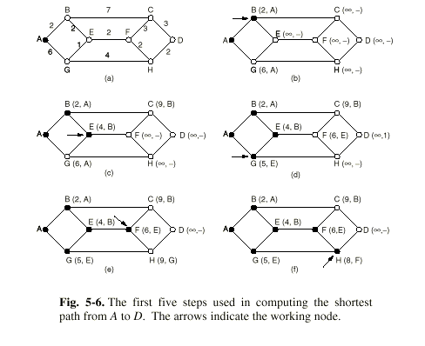
Shortest Path Routing(3) [Example]

Slide 9
Flooding
Brute force routing
Every incoming packet is sent on every outgoing line.
Flooding obviously generates vast numbers of duplicate packets, in fact, an infinite number unless some measures are taken to damp the process.
One such measure is to have a hop counter that is decremented at each hop, with the packet being discarded when the counter reaches zero.

Slide 10
Flooding
Brute force routing
Every incoming packet is sent on every outgoing line.
Always finds the shortest path quickly.
Also finds many long paths.
Time to live is set to size of subnet.
Selective Flooding
Flood only in the direction of the destination.
Practical in a few settings
Broadcast
Military Applications.
Distributed Databases.
Metric for comparison.

Slide 11
Difference between Dijkstra and flooding algorithm
Which one is better?

Slide 12
Dynamic/Adaptive Routing
More complex
More efficient (because they find shortest paths for the current topology)
Computer networks generally use dynamic routing algorithms.
Two most popular Dynamic Routing Algorithms are:
Distance Vector Routing
Link State Routing.

Slide 13
Dynamic/Adaptive Routing
Distance Vector Routing
It operates by having each router maintain a table (i.e., a vector) giving the best known distance to each destination and which link to use to get there.
Neighboring routers periodically exchange information from their routing tables.
Routers replace routes in their own routing tables anytime that neighbors have found better routes.
Information provided from neighbors
Outgoing line used for destination.
Estimate of time or distance.
can be number of hops, time delay, packet queue length, etc.

Slide 14
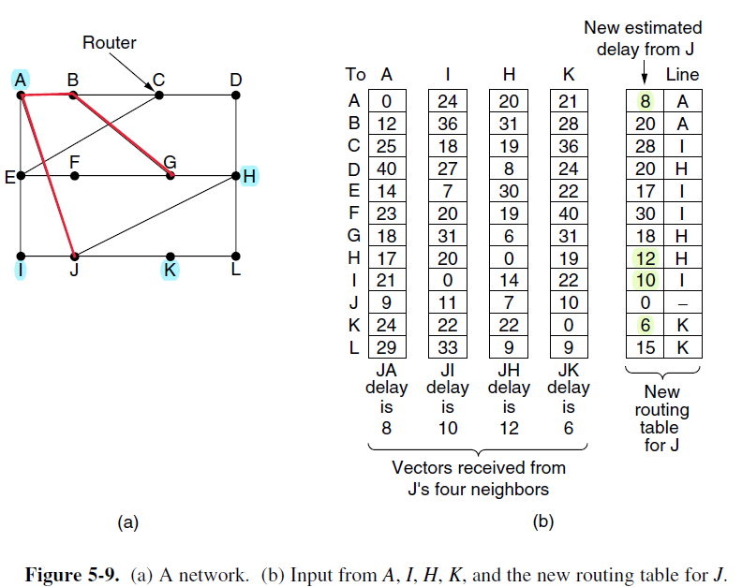
Distance Vector Routing

Slide 15
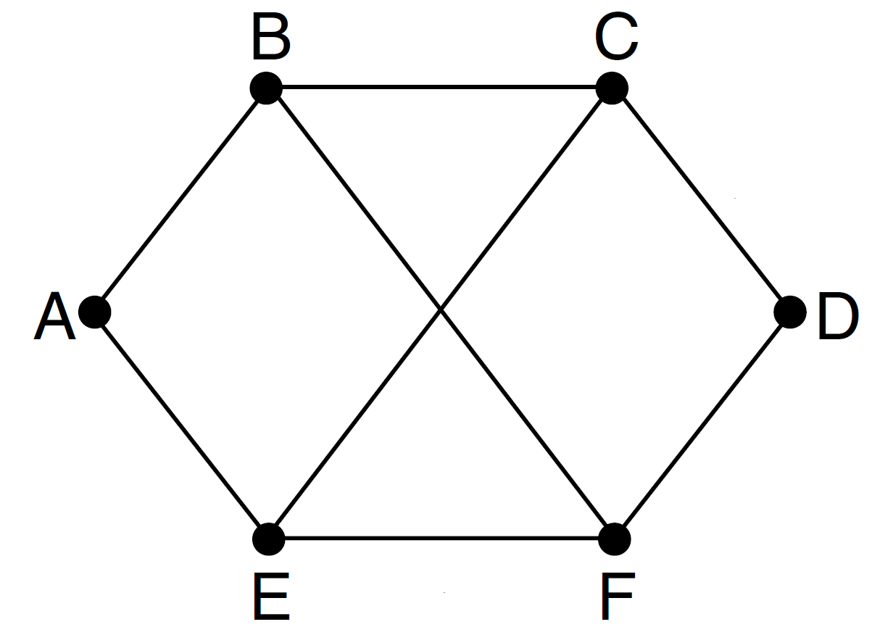
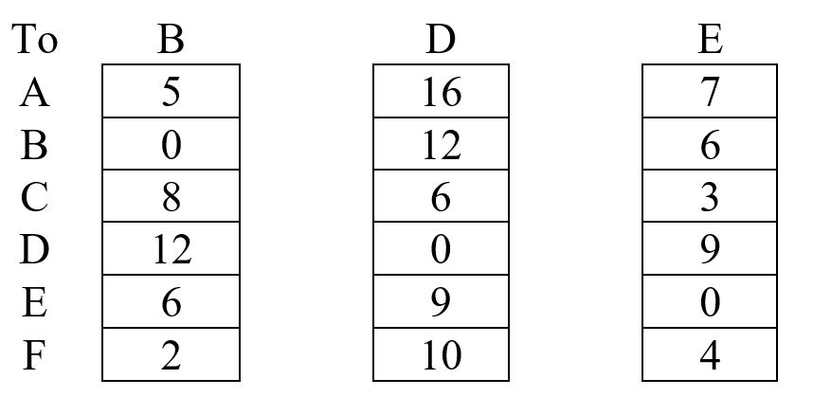
Distance Vector Routing
Consider the network below. Distance vector routing is used, and the following vectors have just come in to router C:
Vectors received from C's 3 neighbors

Slide 16
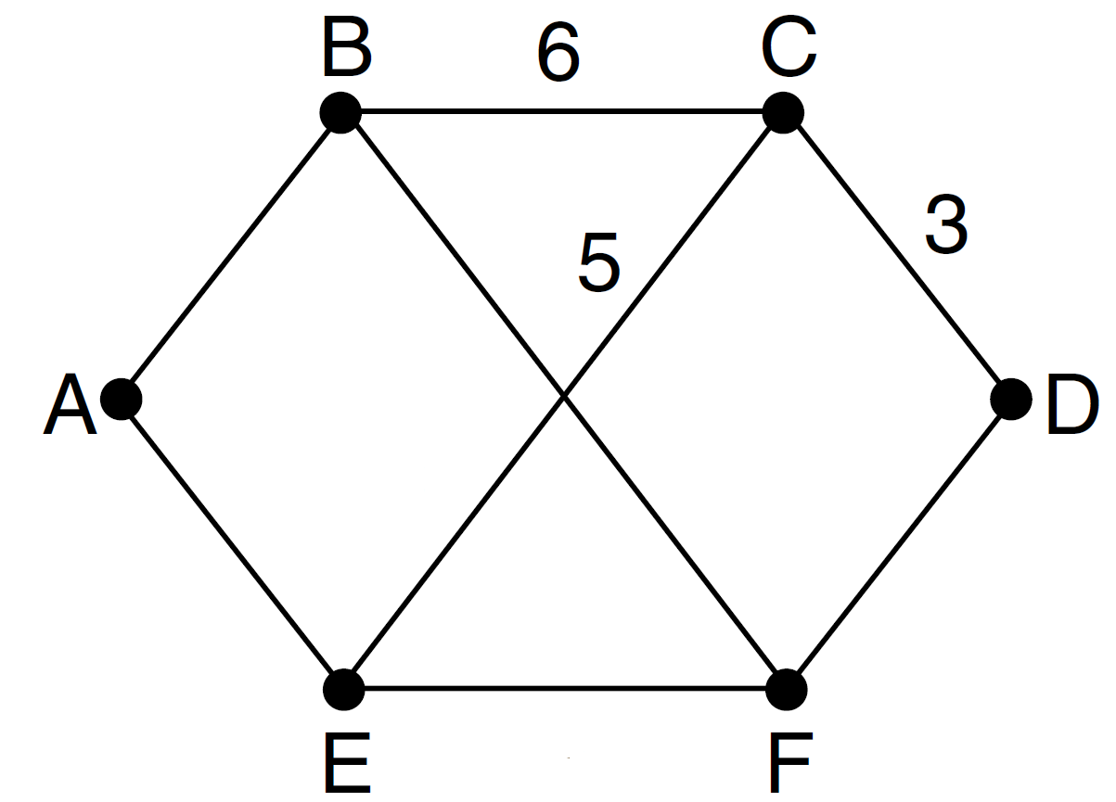
Distance Vector Routing
Consider the network below. Distance vector routing is used, and the following vectors have just come in to router C:
The cost of the links from C to B, D, and E, are 6, 3, and 5, respectively. What is C’s new routing table?

Slide 17
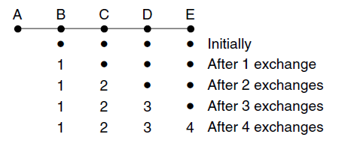
Count–to-Infinity Problem
The settling of routes to best paths across the network is called convergence.
Bad news” Propagate slowly.
“Good news” Propagate fast:
“Good news” typically refers to an improvement in the network's connectivity or the discovery of a new, shorter path to a destination.
Only 4 exchange path converges.
Notes:
Good news: Distance of a path is known
Bad news: Distance of a path is unknown

Slide 18
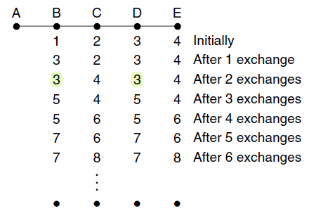

Count–to-Infinity Problem
“Bad news” Propagate slowly.
“Bad news" typically refers to a degradation in the network's connectivity or the discovery of a longer path to a destination.
Even after 6 exchange path doesn’t converges (Slow Converge)
Notes:
Good news: Distance of a path is known
Bad news: Distance of a path is unknown

Slide 19

Count–to-Infinity Problem
“Bad news” Propagate slowly:
The core of the problem is that when X tells Y that I has a path somewhere, Y has no way of knowing whether it itself is on the path.
Suppose Link between A and B is down.
C tells B that “I have path from A”.
B has no way of knowing whether it itself is on the path.
Solution: Split Horizon & Link State

Slide 20
The Split Horizon Hack
Actual distance to a destination is not reported on the line on which packets to that destination are sent.
Instead these distances are reported as “infinity.”
A
B
C
C tells D the truth about its distance to A, but lies to B and says the distance is infinity.
D

Slide 21
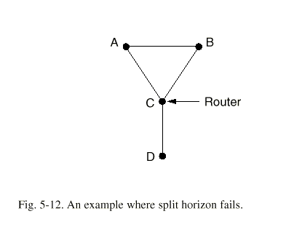
A topology where split horizon fails
Suppose that D becomes unreachable from C. A and B are reporting infinite distances to C, but they are reporting distances of length 2 to each other. A and B will count to infinity.

Slide 22
Link State Routing
Each router must do the following: Five Steps
Discover its neighbors and learn their network addresses.
Measure the delay or cost to each of its neighbors.
Construct a packet telling all it has just learned.
Send this packet to all other routers.
Compute the shortest path to every other router.

Slide 23
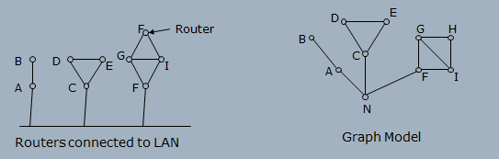
1. Discovering Your Neighbors
“HELLO” packed send on each point-to-point line from a booted router.
Router on the other end must reply by sending its globally unique “name”.
Example of routers connected by a LAN.

Slide 24
2. Measuring Line Cost
It is required by the Link State Routing algorithm that each router to have a reasonable estimate of the delay/cost to each of its neighbors.
Send “ECHO” packet (ping) that the other side is required to send back immediately.
Measure Round Trip time; Divide by 2 to get an estimate.
More accurate estimate by repeating the process several times and by averaging estimates.
Assumes symmetric delay.
Channel Load Issue when Measuring Delay
To factor the load in: round trip timer must be started when the ECHO packed is queued.
To ignore the load: round trip timer must be started when ECHO packed reaches front of the queue.

Slide 25
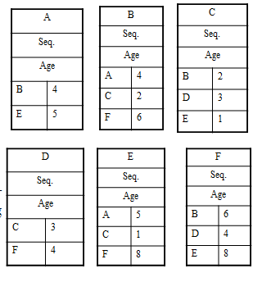
3. Building Link State Packet
A
Seq.
Age
B | 4
E | 5
B
Seq.
Age
A | 4
C | 2
F | 6
C
Seq.
Age
B | 2
D | 3
E | 1
Packet Format:
Identity of Sender
Sequence Number
Age
List of Neighbors
Corresponding Delay
Packets easily built – problem with knowing when to built them.
D
Seq.
Age
C | 3
F | 4
E
Seq.
Age
A | 5
C | 1
F | 8
F
Seq.
Age
B | 6
D | 4
E | 8

Slide 26
4. Distributing the Link State Packets
Distributing Link State Packets Reliably is tricky:
As the packets are distributed and installed, the routers getting the first ones will change their routes before other routers in the network update their routing tables.
Different Routers may be using different versions of the topology (inconsistencies, loops, etc.)
Basic Algorithm: Flooding
Sequence Number (incremented for each new packet sent) is used to keep the flood in check.
Routers keep track of all the source router packets they have been sent to.
New link state packets is checked against the track list:
If new/unseen (based on the sequence number) then it is broadcasted to all neighboring routers with exception of the sender.
If duplicate, it is disregarded.
If sequence number is lower than the highest one in the track list, it is rejected.

Slide 27
4. Distributing the Link State Packets (2)
Problems with basic algorithm:
Sequence Number wrap around.
Make a long precision number (e.g., 32-bit)
Crash of a router: losing track of sequence number.
Corruption of sequence number.
Solution: Include Age of each packet.
Decrement this value once per second.
When zero, this state information is disregarded.
Normally a new packed is send every 10 sec.
Router information times out when:
Router is down, or
A Number of (e.g., 6) consecutive packets have been lost.

Slide 28
Hierarchical Routing
Large Networks:
Proportionally large routing tables are required for each router
More CPU time is needed to scan them
More bandwidth is needed to send status reports.
At certain point network may grow so large where it is no longer feasible for every router to have an entry for every other router.
Solution: Routing has to be done hierarchically.

Slide 29
Hierarchical Routing(2)
Routers divided in Regions (as in telephone network):
Each router knows how to route packets to destinations within its own region.
However, router does not have any information regarding the topology of the network of other regions.
When different networks are interconnected they are regarded as a separate region in order to free the routers in one network form having to know the topological structure of the other ones.

Slide 30
Hierarchical Routing(3)
Huge networks will require more than two-level hierarchy.
How many hierarchical levels are optimal.
Kamoun and Kleinrock (1979): optimal number for an N router subnet is ln(N), requiring total of e*ln(N) entries per router.
Example: Berkley, California Router to Malindi, Kenya.
Berkley to Los Angeles router (out-of-state traffic)
Los Angeles to New York router (international traffic)
New York to Nairobi …

Slide 31
Broadcast Routing
Sending a packet to all destinations simultaneously is called Broadcasting.
Direct Method: Source sends a distinct packet to each destination routers in the subnet:
Wasteful of the bandwidth.
It requires source to have a list of all destinations.
Use spanning tree routing
a subset of the subnet that includes all routers but contains no loops.
Flooding:
Ordinarily ill suited for point-to-point communication:
Generates to many packets, and
Consumes to much bandwidth.

Slide 32
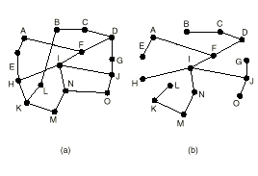
Spanning Tree Broadcasting(2)
Uses the minimum number of packets necessary
Routers must be able to compute spanning tree
Available with link state routing
Not available with distance vector routing

Slide 33
Multicast Routing
A method to broadcast packets to well-defined groups.
Hosts can join multicast groups.
They inform their routers.
Routers send group information throughout the subnet.
Each router computes a spanning tree for each group. The spanning tree includes all the routers needed to broadcast data to the group.
Use spanning tree protocol.

